Slide 1

The Road Ahead: Federal Policy Outlook for Private, Nonprofit Higher Education
Barbara K. Mistick, President
Sarah A. Flanagan, Vice President for Government Affairs
December 9, 2024

Slide 2
Agenda
State of Play: Political & Governing Realities, Campaign Rhetoric
Policy Concerns
Budget Reconciliation: The Fast Track
What We Can Do
Questions

Slide 3
State of Play

Slide 4
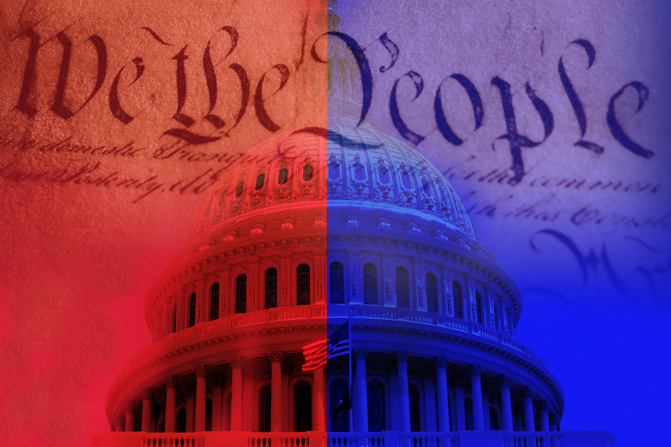
The Political Divide

Slide 5
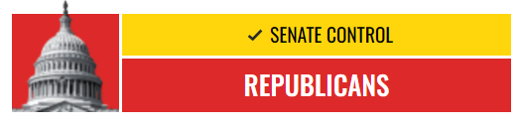
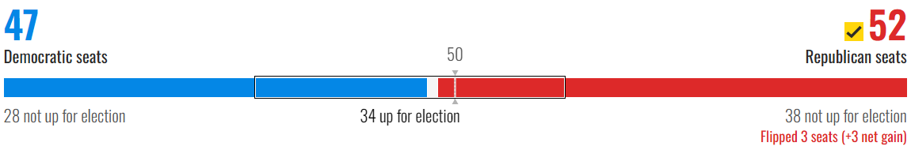
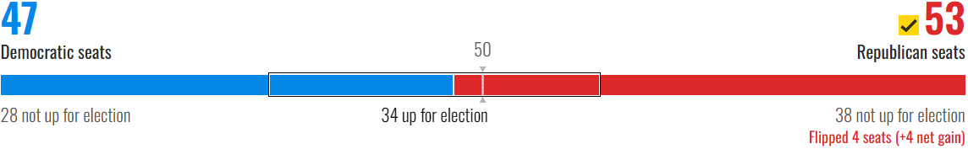
Senate
Majority Leader: Sen. John Thune (R-SD)
Minority Leader: Sen. Chuck Schumer (D-NY)
HELP Committee Chair : Sen. Bill Cassidy (R-LA)
NBC Decision 2024

Slide 6
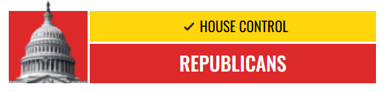
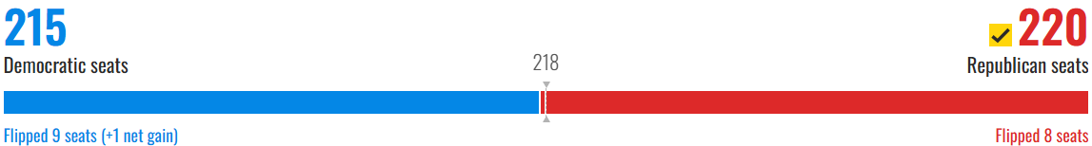
House
Speaker: Rep. Mike Johnson (R-LA)
Minority Leader: Rep. Hakeem Jeffries (D-NY)
E&W Committee Chair: Rep. Burgess Owens (R-UT) and Rep. Tim Walberg (R-MI) vying for seat
NBC Decision 2024

Slide 7
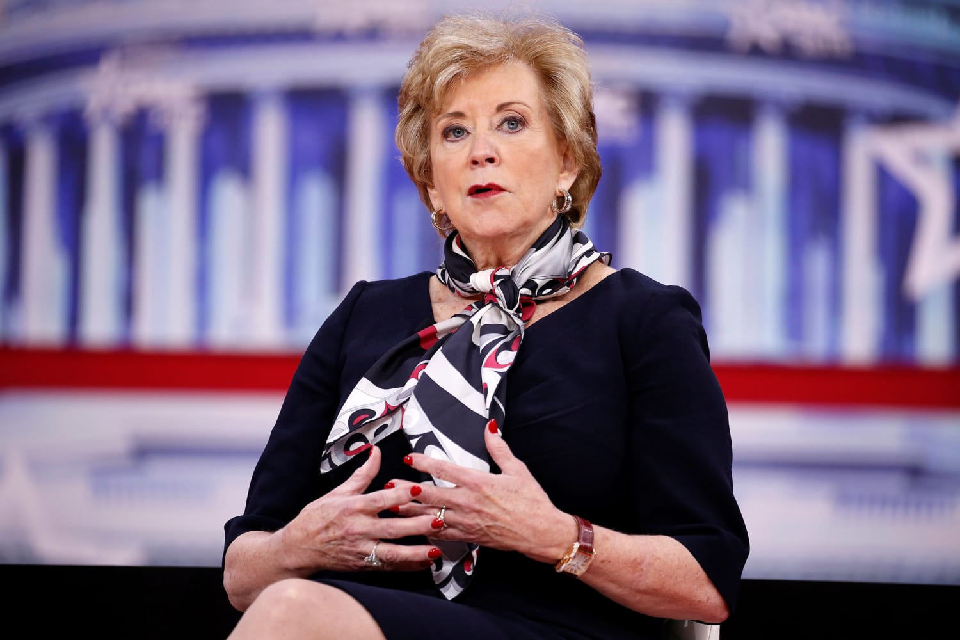
Education Secretary Nominee Linda McMahon
Co-founded World Wrestling Entertainment (WWE), stepped down as CEO in 2009
Former Administrator of the Small Business Administration
Sacred Heart University (CT) Trustee, Finance Committee Chair

Slide 8
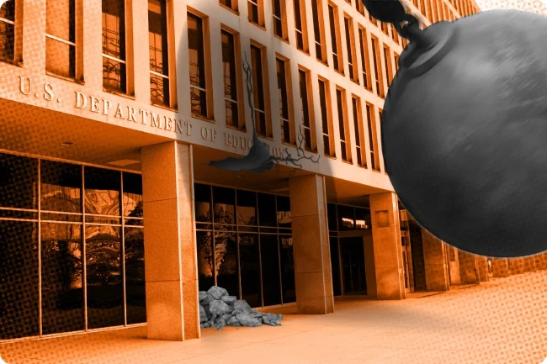
State of Play: Campaign Rhetoric
Abolish the Department of Education
Culture war proposals
Increase/Expand endowment tax

Slide 9
State of Play: Political Reality
Higher education
Political reality
NOT popular with policymakers
Too expensive, too privileged, too woke
Beating up on elite institutions IS easy, good politics
Defending the elite is NOT good politics
NOT well understood by most policymakers
Tuition model; role of endowments; free expression policies

Slide 10
Policy Concerns

Slide 11

Funding
Punt to the 119th Congress
Aspirational Goals
$100 Pell increase in the Senate
Protecting SEOG & Federal Work-Study

Slide 12

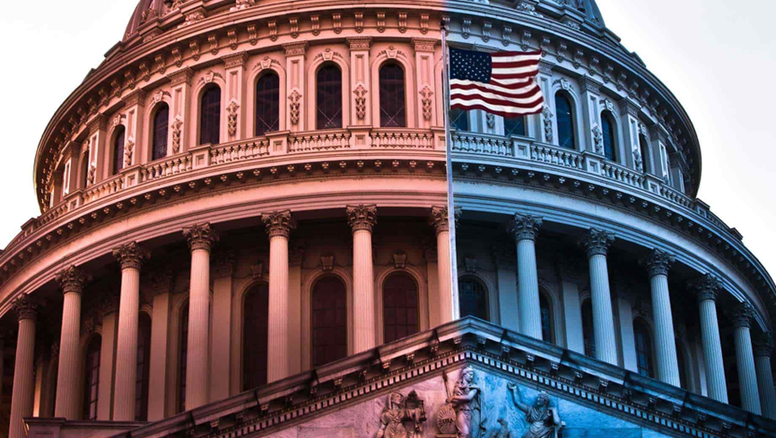
Institutional Risk-Sharing: A Major Idea in the House
College Cost
Reduction Act
Efforts to implement federal loan cost-sharing based on former students' repayment and career choices
Bipartisan Workforce Pell
Federal loan cost-sharing on colleges and universities paying the endowment tax

Slide 13
College Cost Reduction Act (CCRA)
Risk Sharing Payments
Non-Repayment Balance
A combination of unpaid loans, interest waived for borrowers on income-based repayment, and forgiven loans
Risk-Sharing Percentage
A ratio of what students earn after graduation to what they paid for their education

Slide 14
College Cost Reduction Act (CCRA)
Limits
Total federal student aid to median cost of attendance by program
Ends
Grad and Parent PLUS loans
Establishes performance-based funding program for schools

Slide 15
Projected Net Loss Under CCRA
585 Schools
177 Schools

Slide 16
Level Set: Current Endowment Tax
Passed into law in 2017, final regulations issued in 2020
1.4% tax on the net investment income of eligible institutions
Institutional eligibility conditions
Private college or university (public institutions exempted)
Enroll at least 500 tuition-paying students, >50% located in USA
Endowment assets of $500,000/student or greater
No official government list of affected institutions
2021: 33 institutions, $68.1 million paid to IRS
2023: 56 institutions, $381 million paid to IRS

Slide 17

Large-Scale Tax Reform Bill in 2025
Expansion of the endowment tax and new taxes on nonprofits generally
17 current bills in Congress to expand the endowment tax
Sen. JD Vance bill would increase the percentage of the tax formula from 1.4% to 35% but exclude nonsecular institutions
Student and family benefits could be at risk

Slide 18

Other Key Issues
International Students and DACA
Accreditation
Scrutiny over DEI

Slide 19

Accreditation
Without legislative changes, the Department…
Cannot:
Take away an institution’s accreditation. Only an accreditor can do that.
Require or prevent accreditors from adopting their own accreditation standards.
Require institutions to change accreditors.
Can:
Recognize new accreditors.
Attempt to deny federal recognition to existing accreditors (who have appeal rights).

Slide 20
Potential Opportunities
1
2
3
4
No automatic overtime adjustments
Possible regulatory rollbacks (but not FVT)
Free public college not on the agenda
NLRB: student workers and athletes ≠ employees

Slide 21
Deregulation: The Process
Regulations can only be reversed by the process under which they were enacted (unless superseded by legislation)
Don’t forget about enforcement discretion
E.g., FVT via neg-reg, Title IX via notice-and-comment rulemaking, etc.
E.g., will be a big factor with Title VI
Guidance can be issued or withdrawn at any time

Slide 22
Budget Reconciliation: The Fast Track

Slide 23
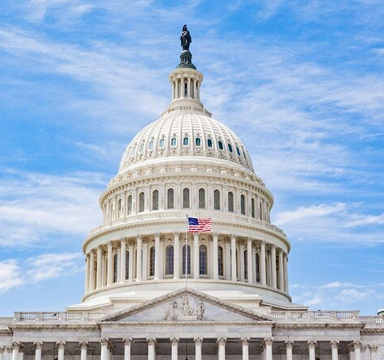
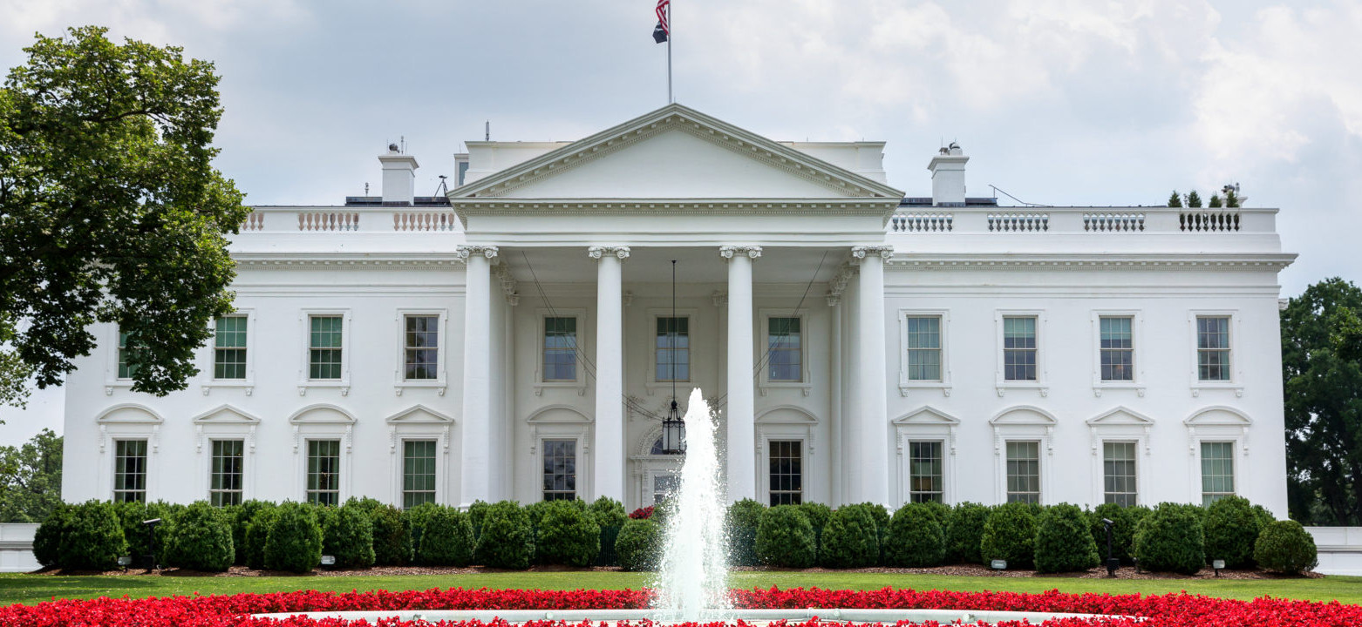
Governing Realities
Senate: 53-47, Republican majority
House: 220-215, Republican majority
Department of Education: Secretary-nominee Linda McMahon
Budget Reconciliation
Republican-led
President-Elect Donald Trump
Simple majority needed in Senate, bypasses 60-vote filibuster

Slide 24
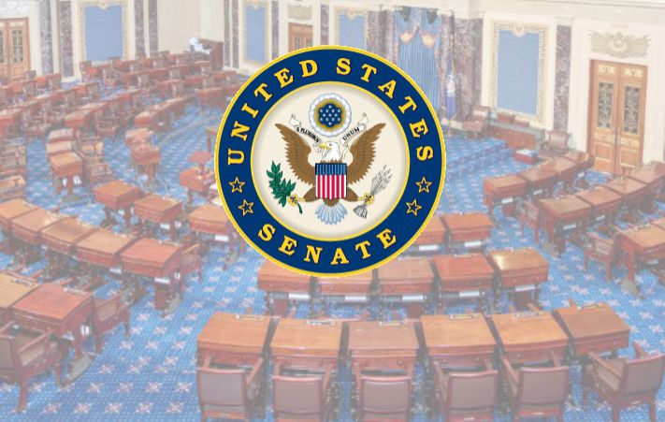
What is Budget Reconciliation?
Fast-track process in the Senate
Limited hours of debate – no filibuster allowed
Limited amendments – provisions must be germane
Simple majority – 50 votes – for passage

Slide 25



Reconciliation for Education
If Education committees receive an instruction, they must raise money from the Federal Student Loan Program, as it is the only entitlement program under their joint jurisdiction
Process has been used by both parties to pass partisan tax, healthcare, and student loan bills
CCRA would save $185 billion in the student loan program

Slide 26
What We Can Do

Slide 27
Advocacy Mindset
Cultivating an advocacy mindset on behalf of your institution and our sector with elected officials.
Advocacy
Positive outcomes

Slide 28
Next Steps
Identify who on your campus is stewarding relationships with policymakers.
Are policymakers in your stewardship portfolio? If not, could they be?
Are there other constituencies that you need to engage?

Slide 29
Engaging Elected Officials
How to talk with a legislator
Relax: Legislators, and their staff, are people, too.
Make it real: Introduce your institution and tell your story.
Be direct: Ask the question, “can you support our students by voting for/against a bill or funding?”
Don’t speculate.
Listen and be fair and unbiased.
Be yourself.
Types of meetings:
On-boarding
Home – on campus
Away – Washington D.C.
State Association
NAICU Advocacy Day

Slide 30
Immediate Action: Oppose Risk Sharing in CCRA
1.
2.
3.
Contact your State Executive (if you have one).
Call your members of Congress.
Advocate in Washington, D.C. February 4, 2025.

Slide 31
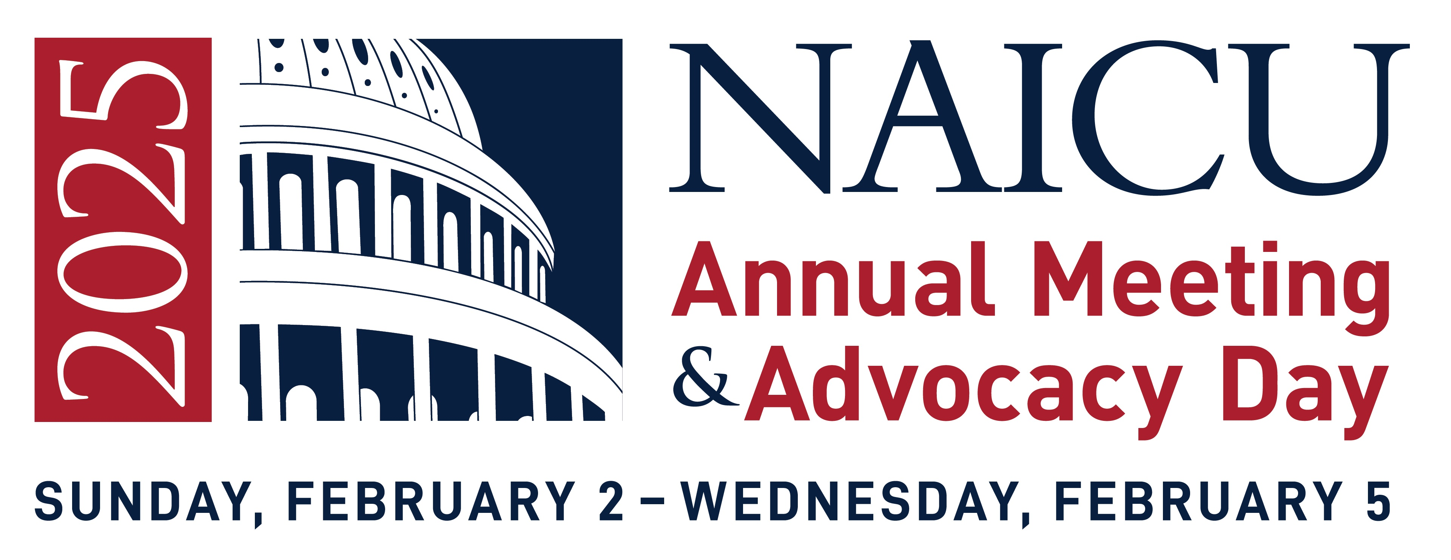
Registration is open!
Advocacy Amidst Upheaval: Thriving in an Uncertain Political Era

Slide 32
Questions and Discussion

